Slide 1

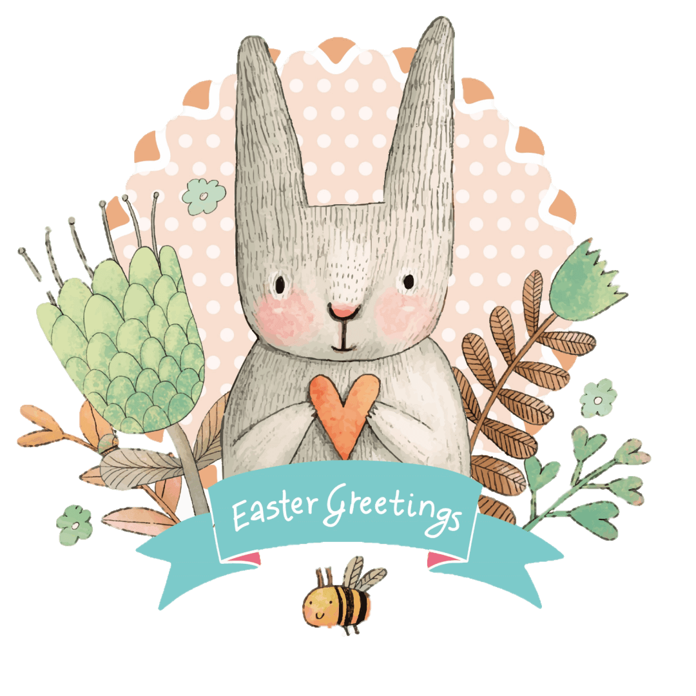
Easter
By Fanni Sike 11.k

Slide 2
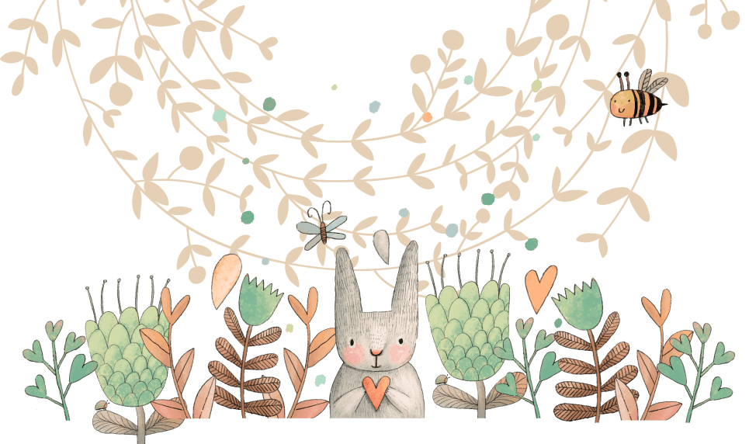
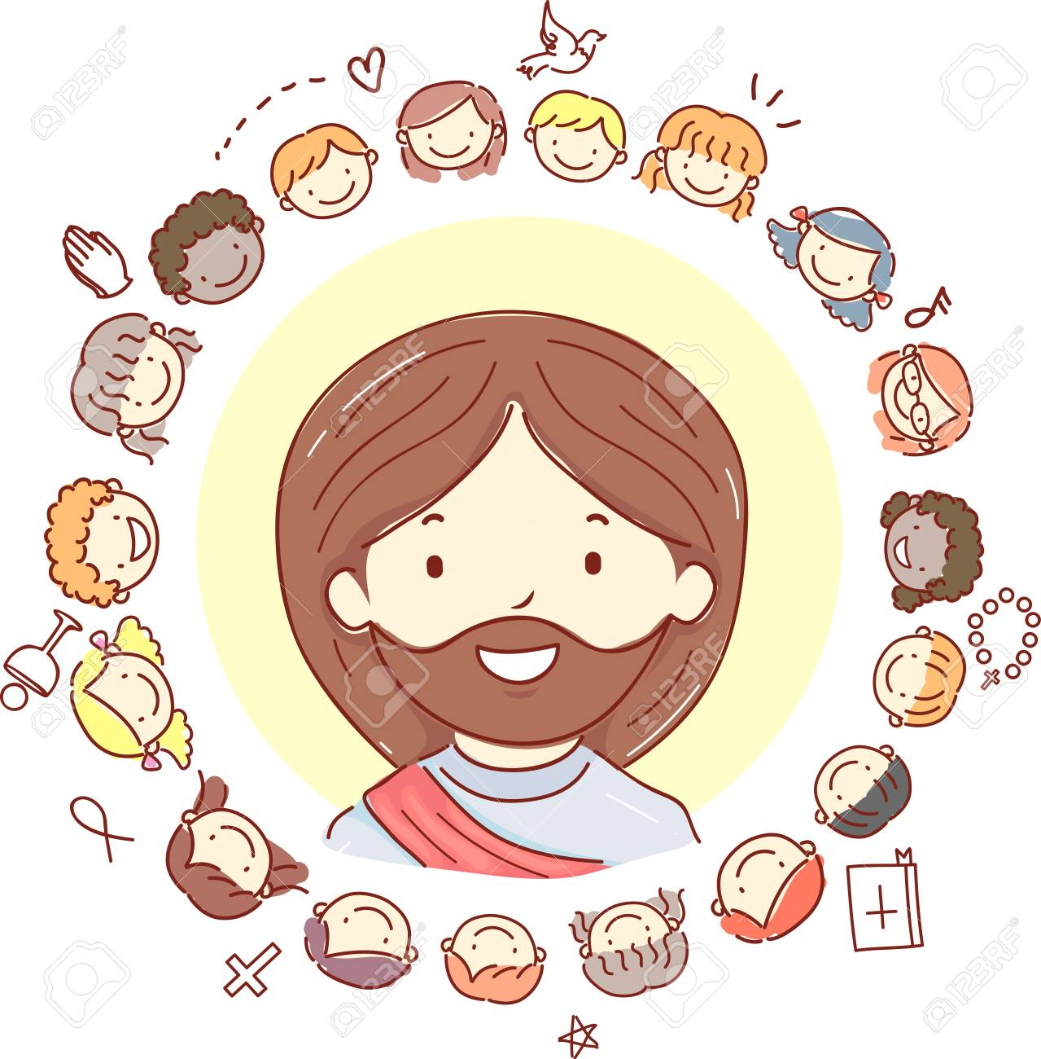
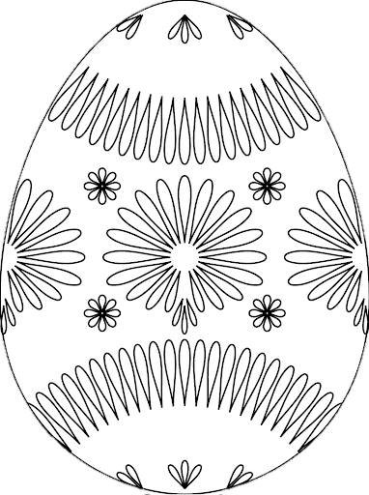
What does it mean?
Easter is a spring festival of new life.
The name comes from the Anglo-Saxon.
Easter celebrates the resurrection of Jesus Christ.
Easter celebrates life and rebirth, which is why we see lots of symbols of new life and fertility at Easter, like eggs, chicks and rabbits.

Slide 3
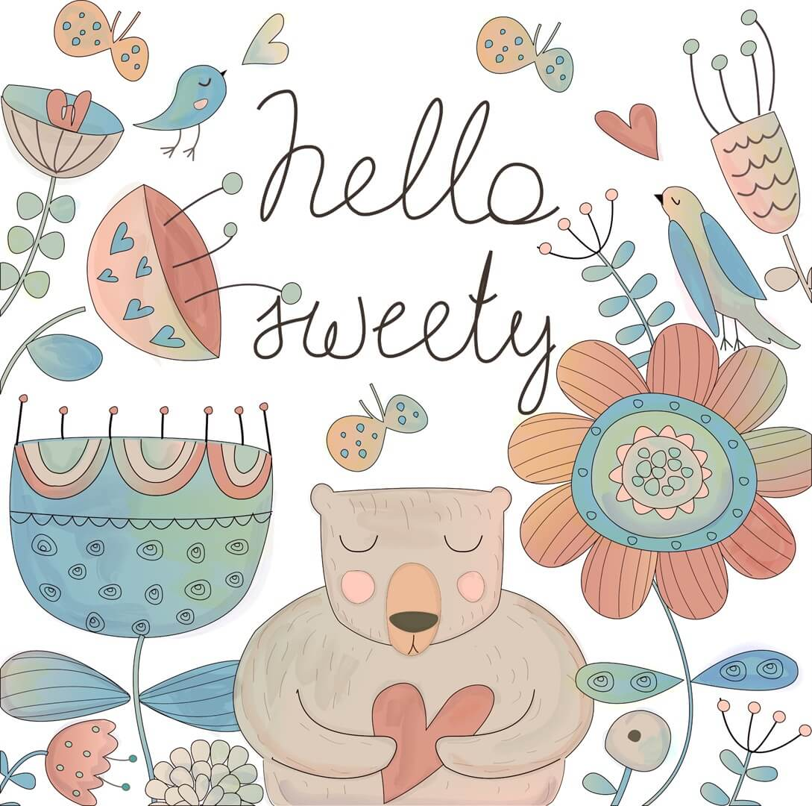
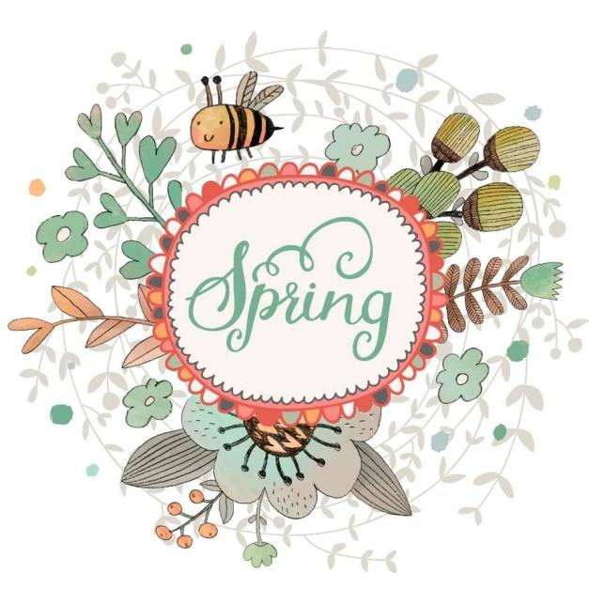
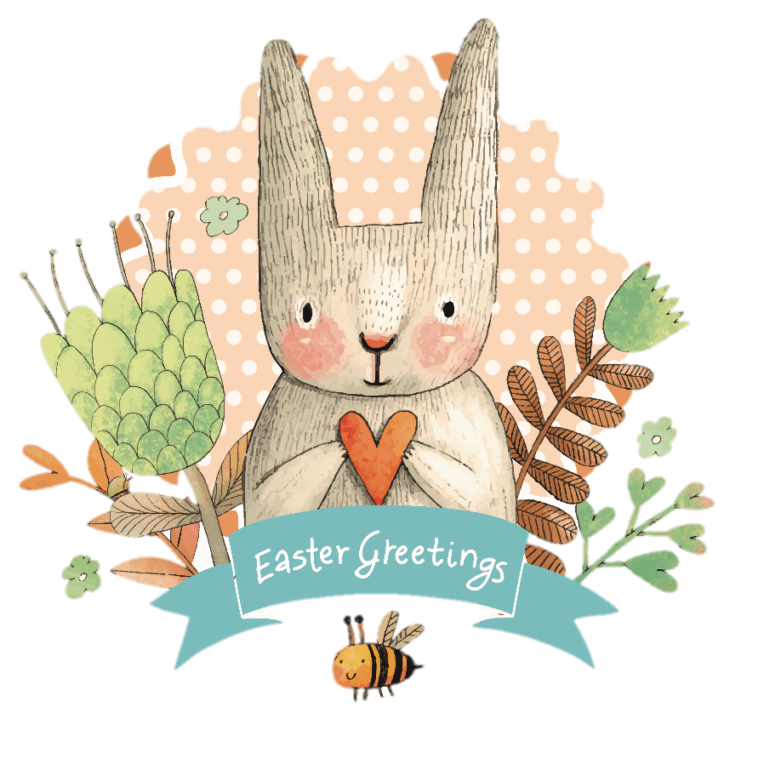
Easter isn’t on the same date each year.
It takes place on the first Sunday after the first full moon of spring.
When is it?

Slide 4
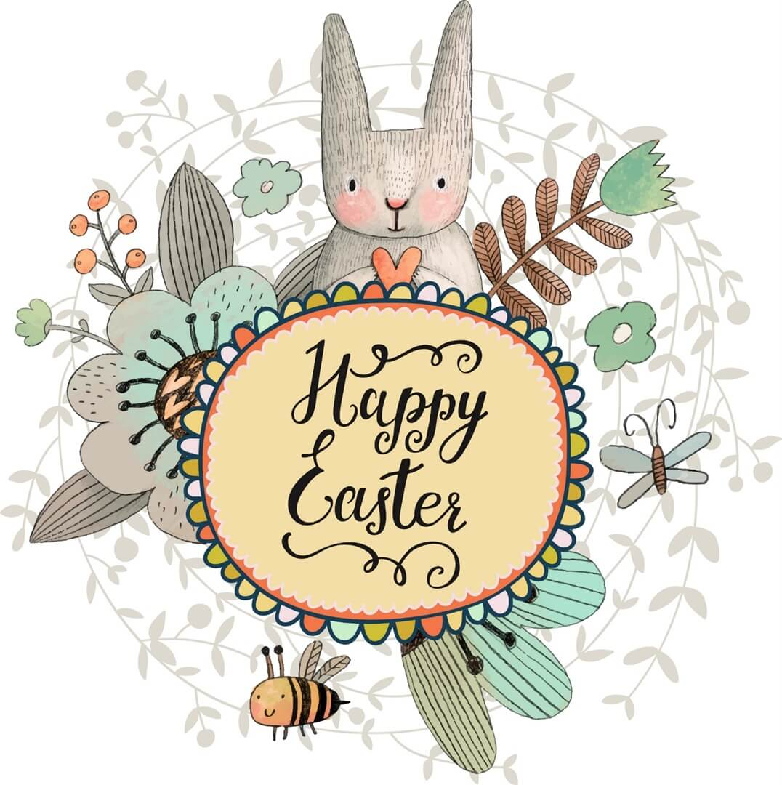
For most British children, Easter means chocolate Easter eggs.
90 million chocolate eggs are sold in the UK each year.
Chocolate eggs
The shops are full of bright Easter displays decorated with chicks, rabbits and flowers, all with the objective of selling chocolate eggs in huge numbers.
Doctors and dentists would advise people to eat Easter eggs in moderation.

Slide 5
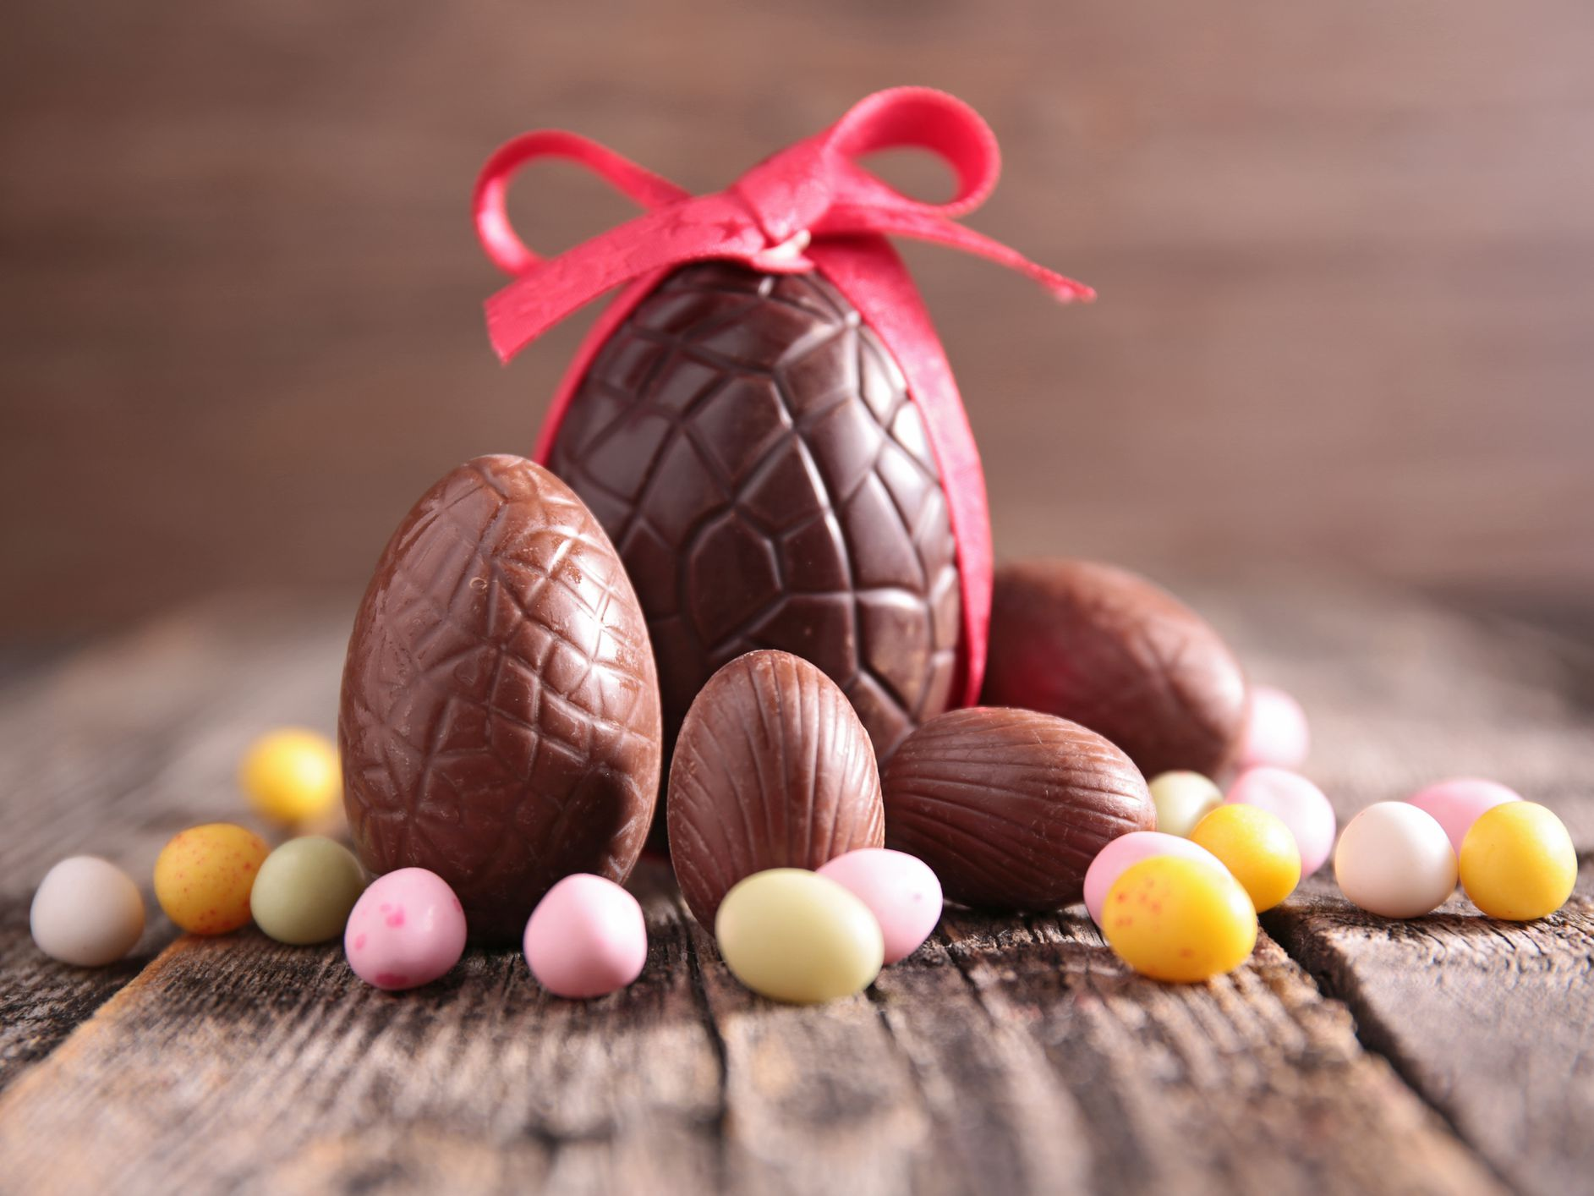
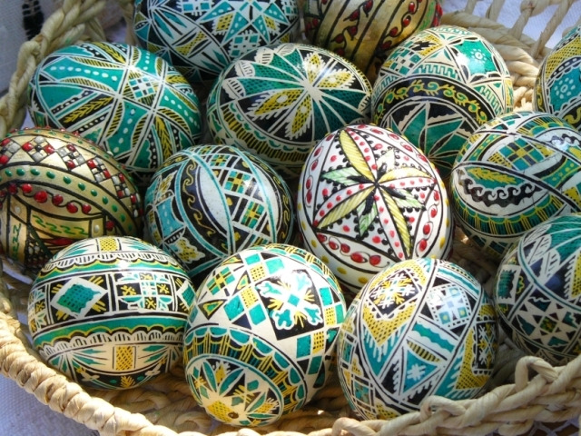
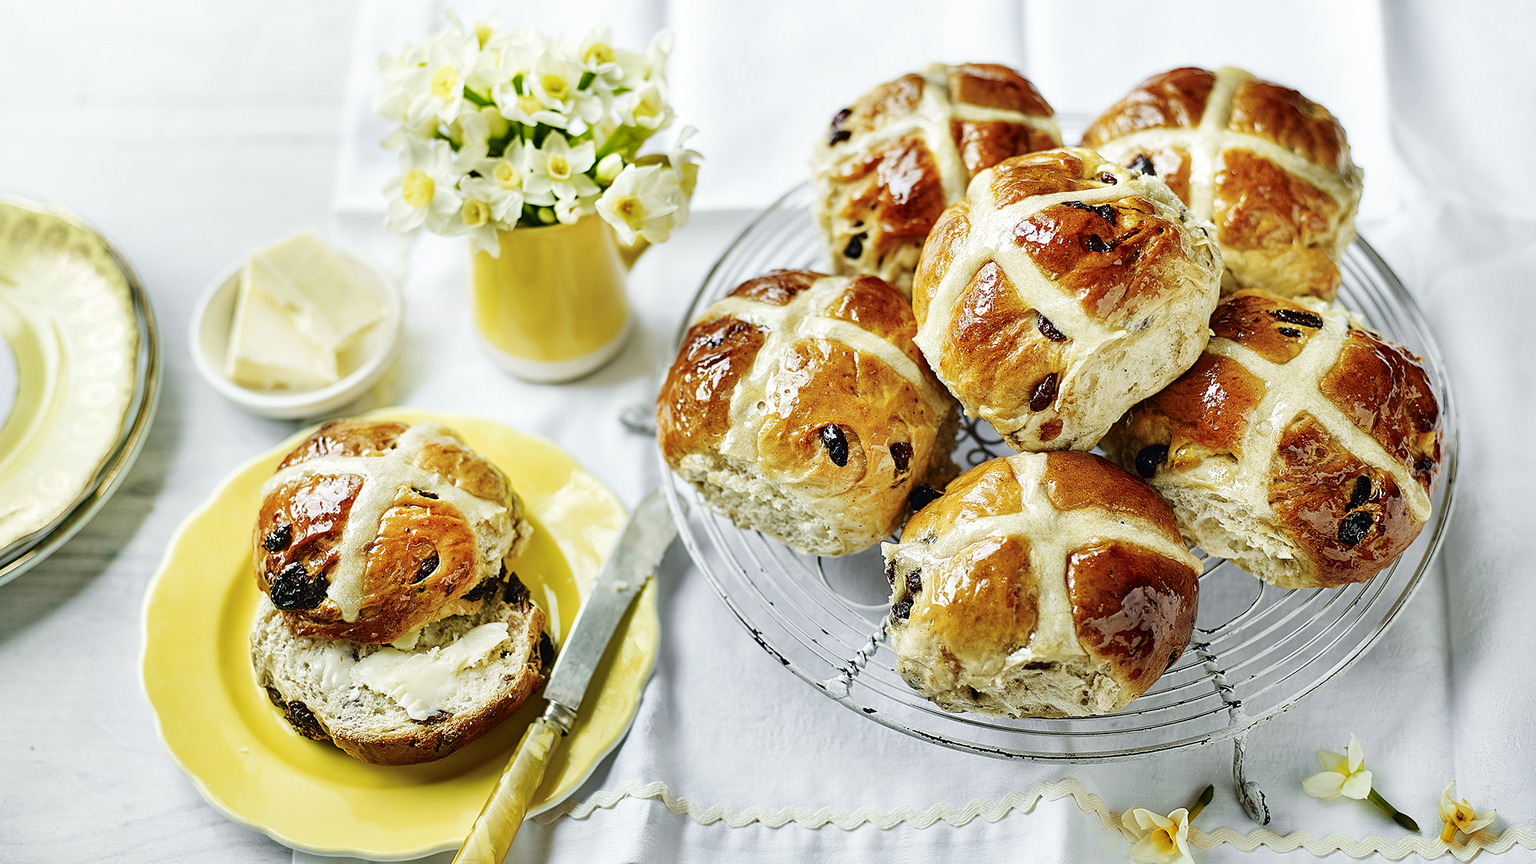
Other 'egg-straordinary' traditions
Chickens’ eggs are painted and decorated to be given as presents, and eggs are also hidden for children to find as part of an 'egg hunt'. Some places even hold competitions to see who can roll an egg down a hill without breaking it.
There are other special foods, too. Hot cross buns are typical cakes that are made at Easter time.

Slide 6
Thank you for your kind attention!
Based on: https://learnenglishteens.britishcouncil.org/uk-now/read-uk/easter

